Slide 1
Ballet 1, Ballet 2, and Beginner Men's Dance Dress Code Requirements 2024-2025

Slide 2
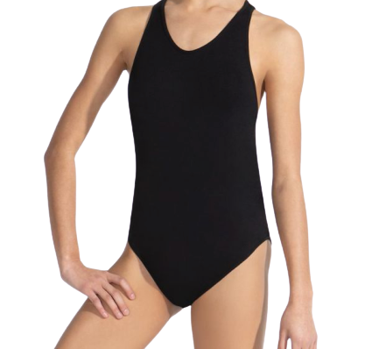
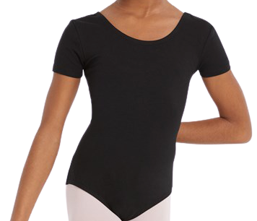
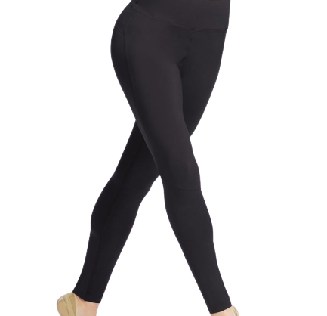
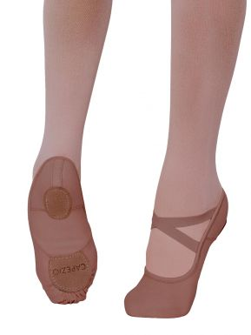
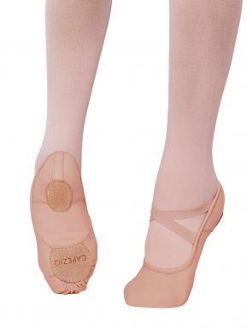
DRESS CODE REQUIREMENTS
for Ballet 1 & Ballet 2 (females) Grading for wearing attire begins Wednesday, September 4th
3. Ballet shoes
(leather or canvas, full or split sole are permitted)
Students may choose from traditional “Ballet Pink” or a color that compliments their skin tone.
Female students should NOT wear black or white shoes.
1. Solid black leotard
(Any sleeve length except spaghetti straps)
2. SOLID black leggings
(ankle or capri length are fine)
NO mesh, cutouts, or prints
OR

Slide 3
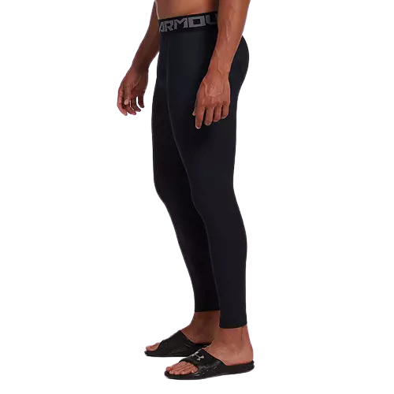
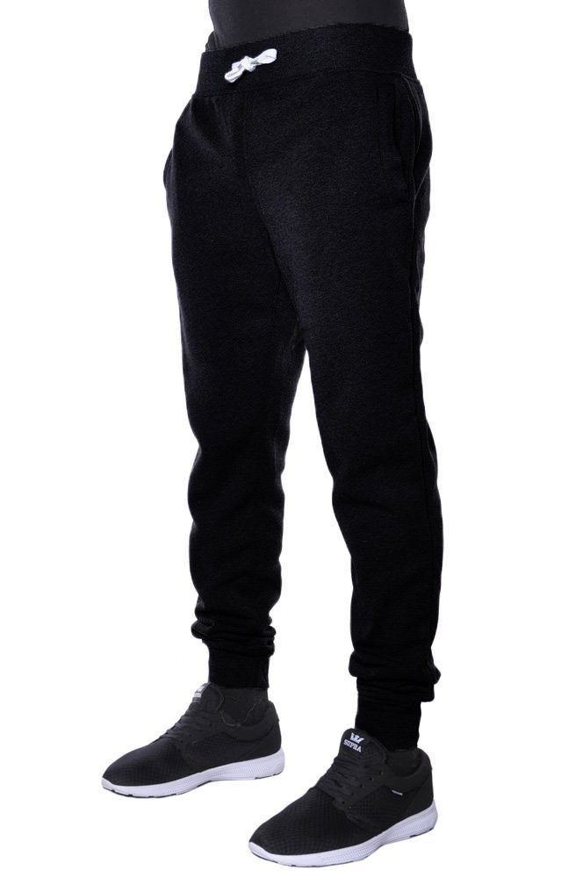
DRESS CODE REQUIREMENTS
for Beginner Men’s Dance & Male Ballet 2 Dancers
Grading for wearing attire begins Wednesday, September 4th
2. Solid black sweatpants/joggers or compression leggings
(no athletic shorts or jeans)
1. SOLID black t-shirt
(no large logos)
3. Solid black Ballet shoes (leather or canvas)
OR

Slide 4
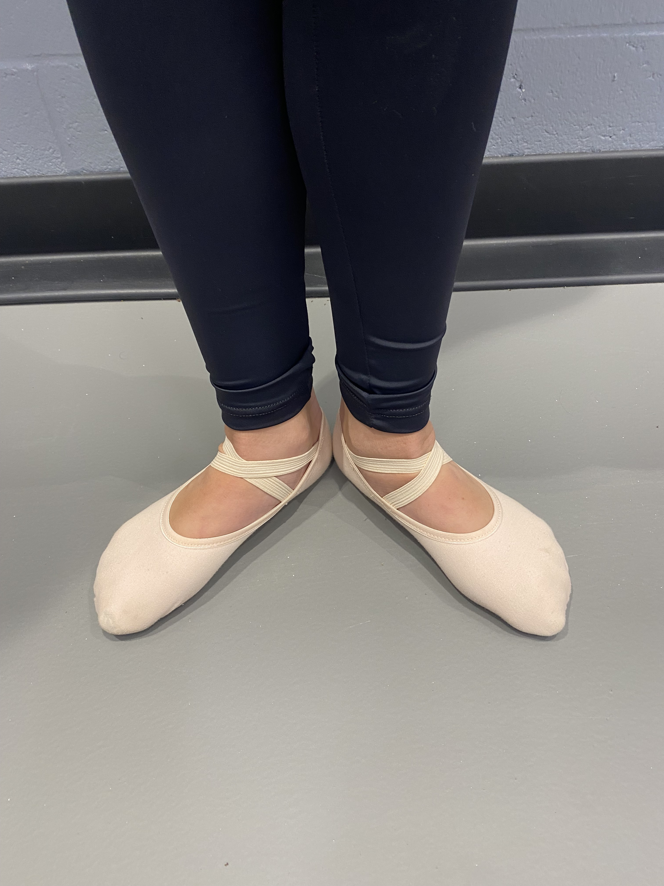
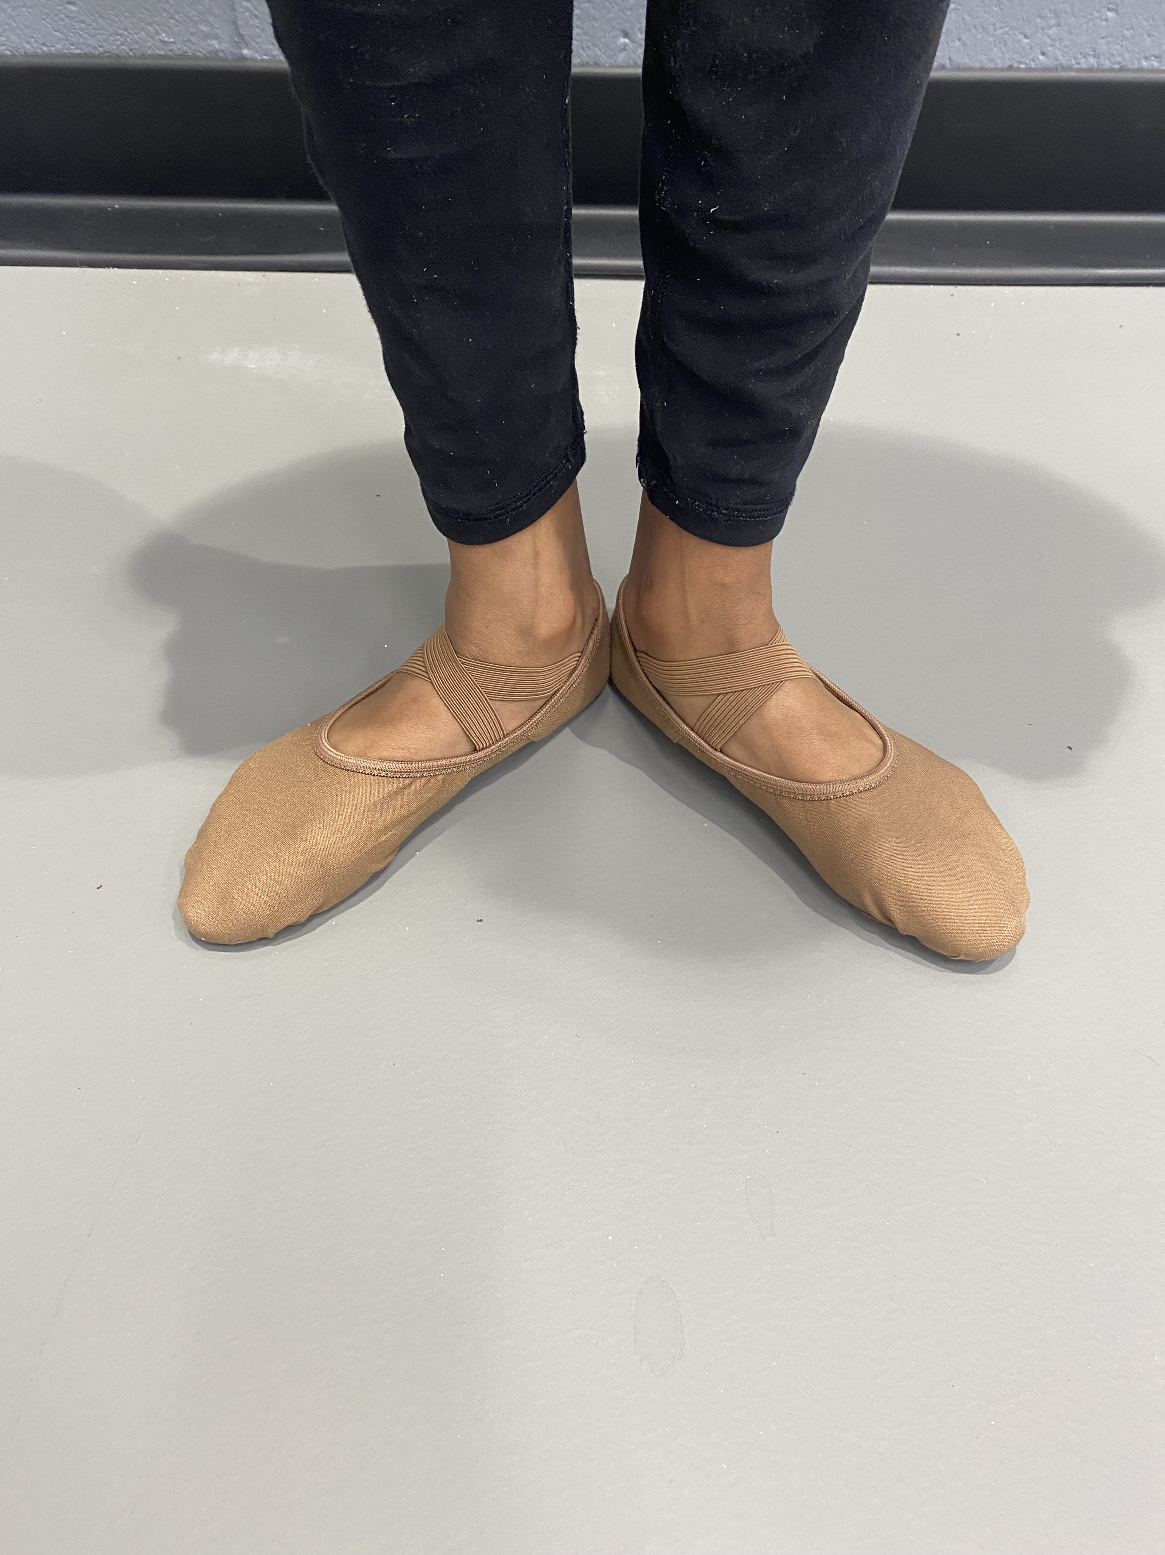
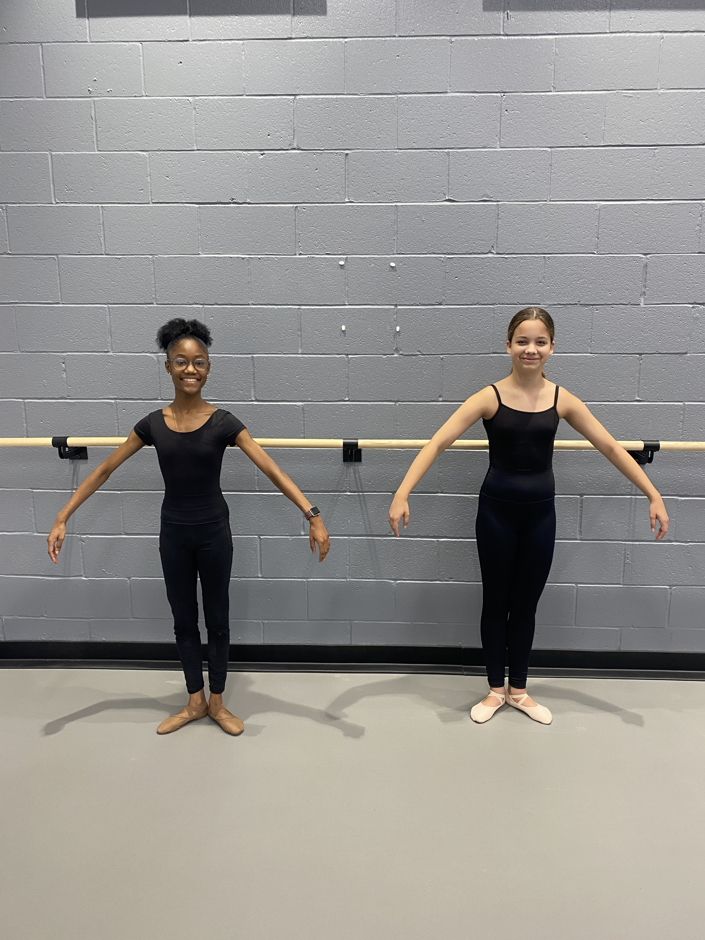

Slide 5
Where do I purchase these items?
Shoes: "Tutus and Dance Shoes" on Davis Road to ensure best fit. The owner's daughter is a DFA graduate, and they have great customer service.
Leotard: Shop locally at "Tutus and Dance Shoes" or online at Amazon, Discount Dancewear, etc.
Leggings (Joggers/T-shirts for boys): Any brand is fine. I recommend going simple and cheap as possible. Walmart, Target, etc. Buy 2 pairs if possible.
Students must begin wearing their dance attire beginning Wednesday, September 4th, 2024.
Please email Mrs. Daniels with any questions or concerns (danieco@richmond.k12.ga.us)

Slide 6
Not required but STRONGLY recommended:
1. If students CHOOSE, they will be assigned a dance locker (located in the Locker Room where they change clothes). There is no fee for the use of these lockers, however students must provide their own LOCK.
DO NOT SEND IN LOCKS THAT REQUIRE A KEY. Students have difficulty keeping up with the key.
DO NOT SEND IN LOCKS WHERE THEY SET A DIAL FOR EACH NUMBER. These locks often malfunction and must be cut off.
STUDENTS MUST REGISTER THEIR LOCKER COMBINATION WITH MRS. DANIELS.
STUDENTS MAY HAVE TO SHARE LOCKERS WITH A BUDDY.
2. Using a small “delicates” laundry bag with zipper.
Keeps students gear together when transporting from school and home.
Reduces items being dropped/lost.
Can be found wherever laundry detergent is sold (Grocery store, Target, Amazon).
SEE THE NEXT TWO SLIDES FOR PHOTO EXAMPLES

Slide 7
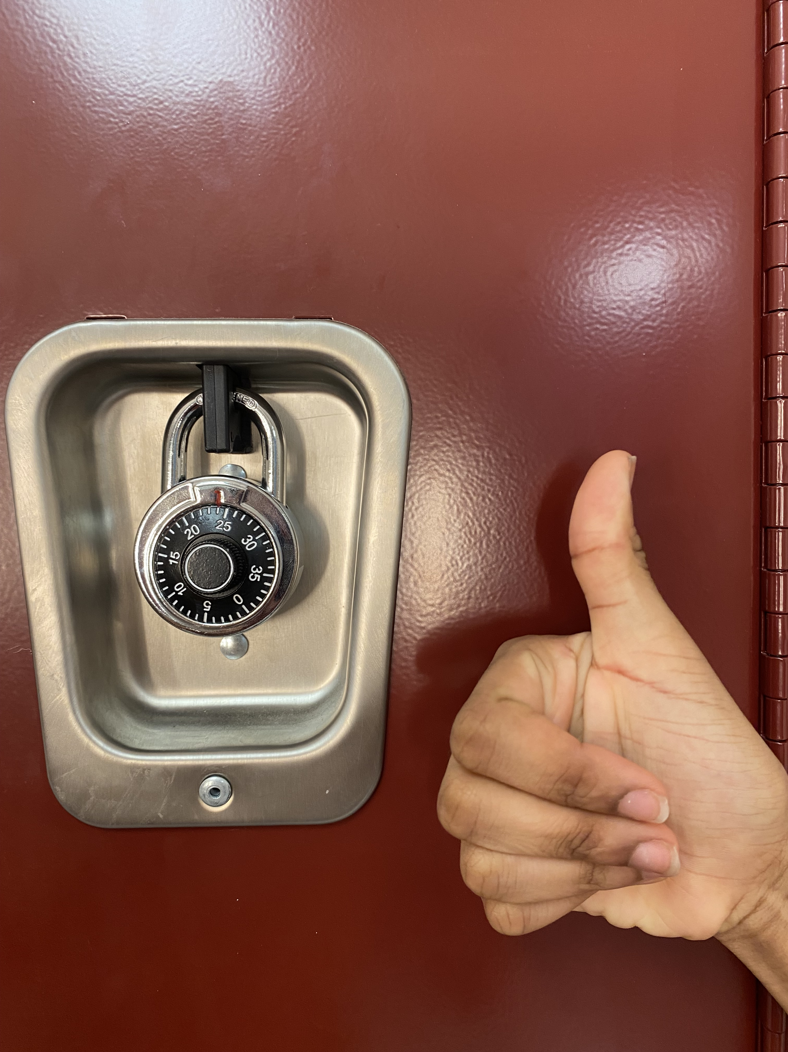
NO
NO
YES

Slide 8
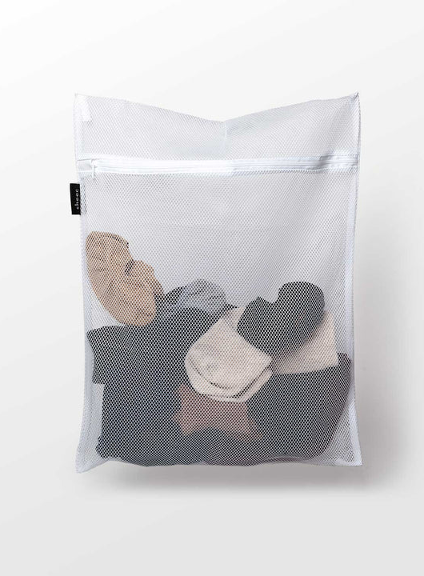
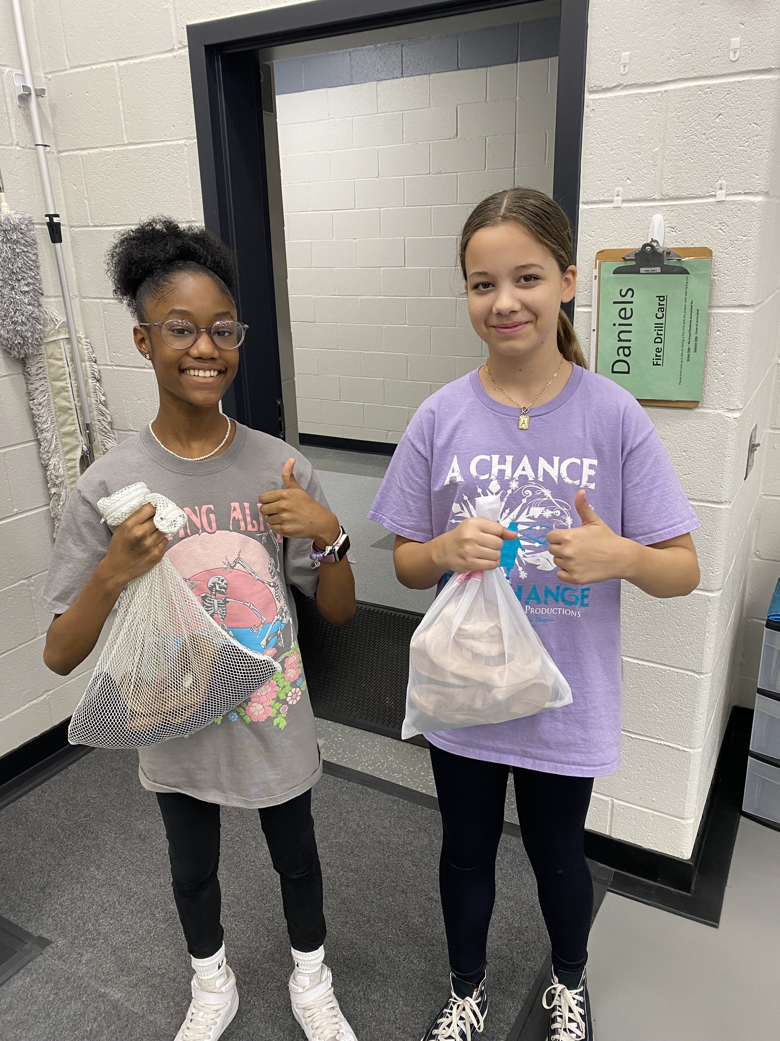
Keep your dance items together and prevent them from getting lost!
Don't forget to label everything with your name.

